Slide 1
Project Proposal: Skin Cancer Classification
Soheil Mohammadpour
231754

Slide 2
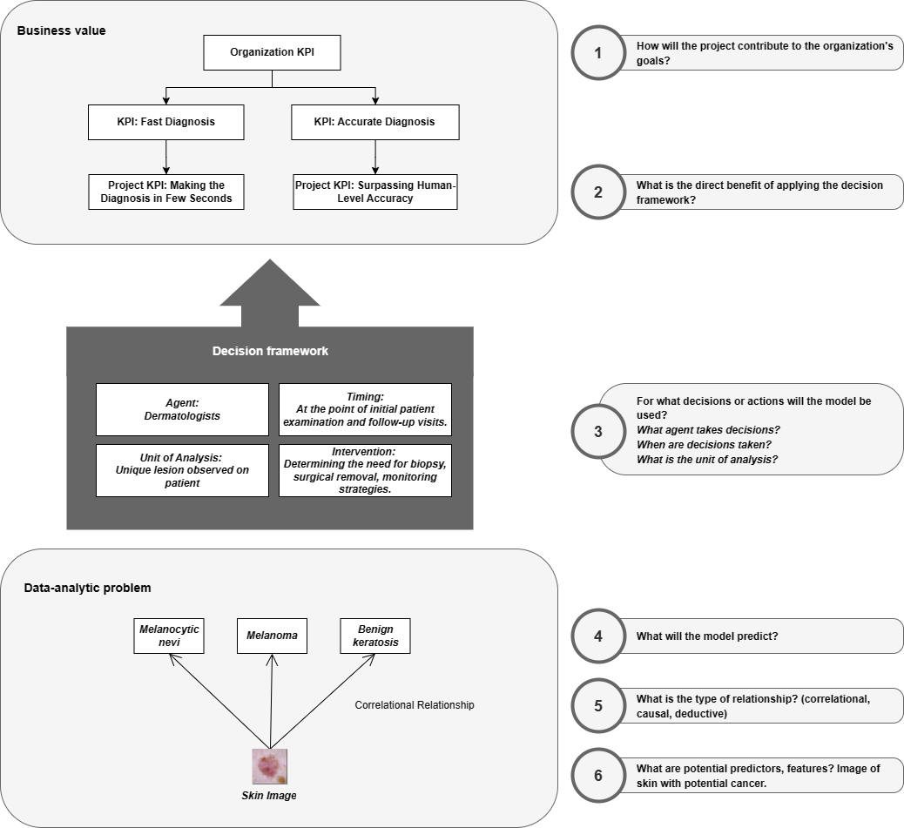
Project Pitch
Business Understanding
Create the first idea for your application:
Problem statement: Current methods of skin lesion diagnosis are subjective and prone to error. There's a need for enhanced speed and precision.
Main stakeholder: Dermatologists, who require fast, accurate, and reliable diagnostic tools.
Application idea: Development of an AI application for image-based classification of skin lesions to assist dermatologists in clinical decision-making.

Slide 3
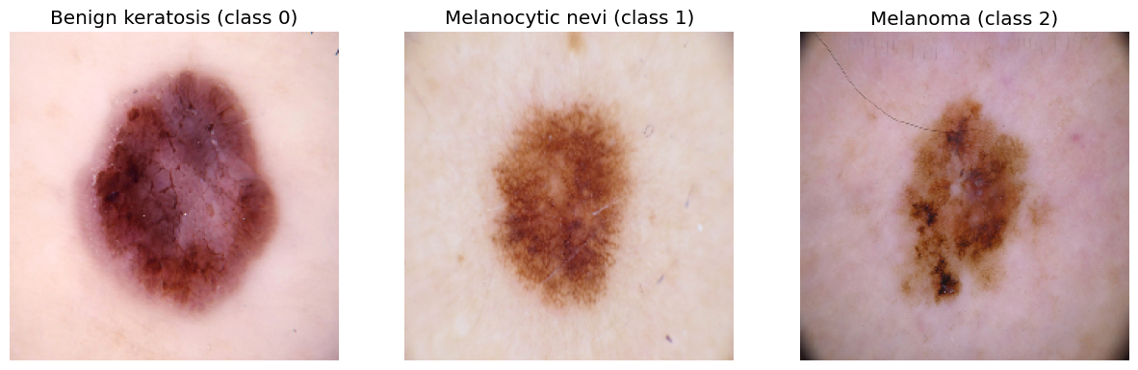
Problem Overview
Deep Learning
Explain your image classification problem:
The model will classify different types of skin lesions.
There are three classes (i.e.., Melanocytic nevi, Melanoma, Benign keratosis)
There are 1099 images per class.
Baselines:
Random guess: 33.33% accuracy
Human level accuracy: 37.5%
MLP: 48.92% Accuracy

Slide 4
Model Overview
Deep Learning
Explain the process of creating and training your image classification model:
Four iterations have been implemented:
Iteration #1: Simple CNN model + no augmentation
Iteration #2: Simple CNN model + data augmentation
Iteration #3: Transfer learning + no data augmentation
Iteration #4:Transfer learning + data augmentation.
In the last iteration, the Inception-ResNet model is implemented by applying 5 different data augmentations (i.e. vertical/horizontal flip, rotation range, width/height shift)

Slide 5
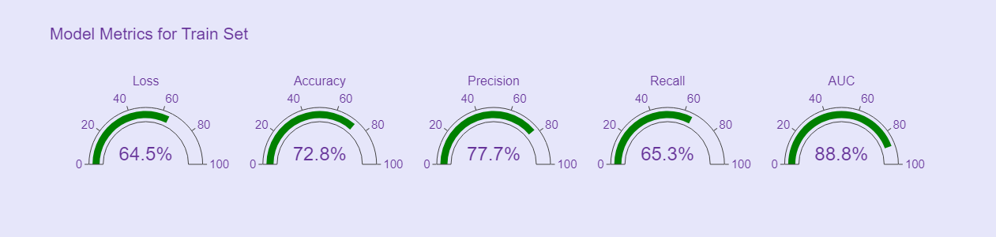
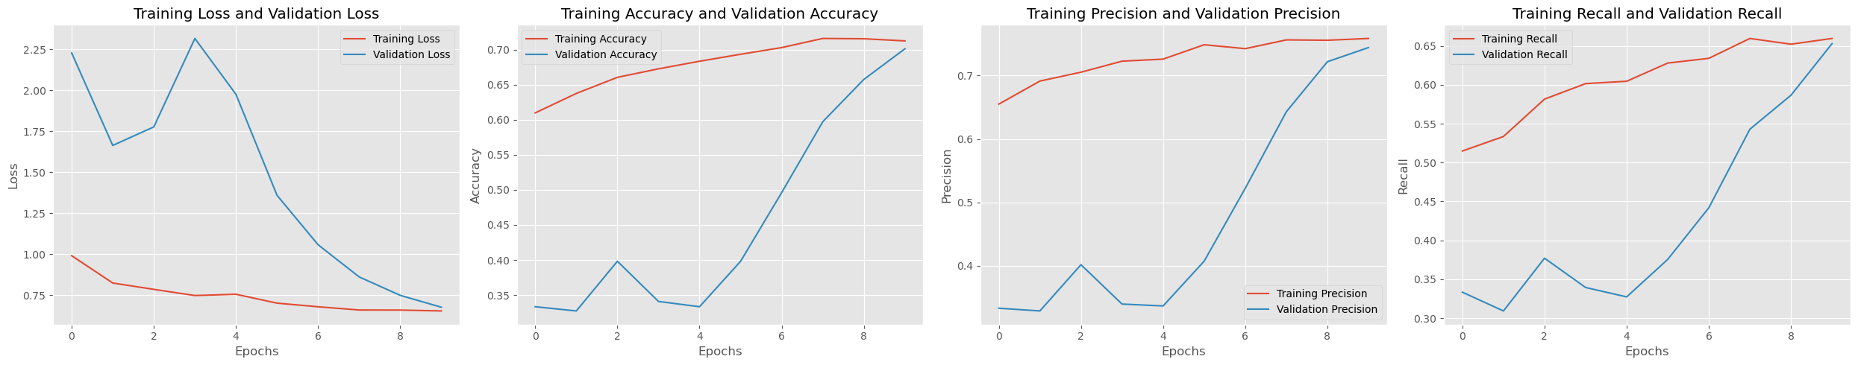
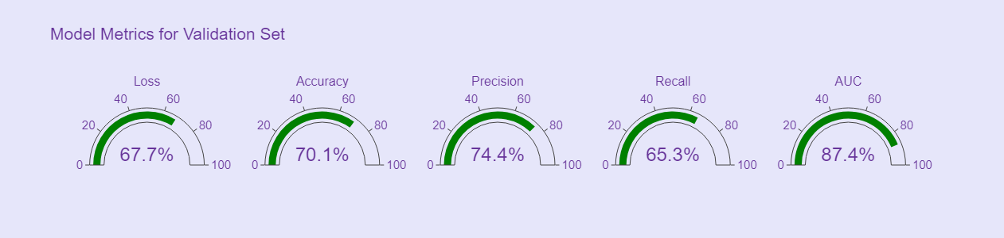
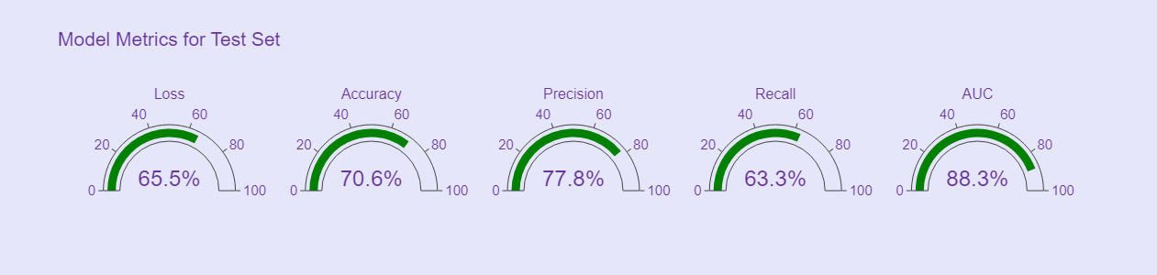
Model Performance
Deep Learning

Slide 6
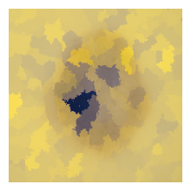
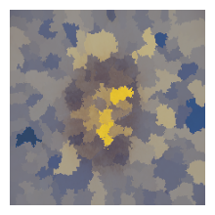
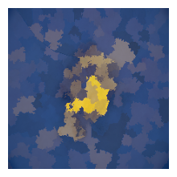
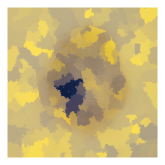
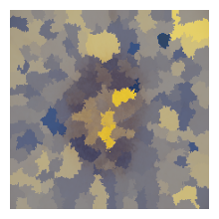
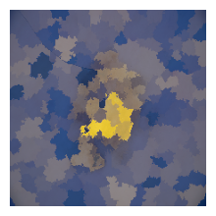
Model Interpretability
Responsible AI
Discuss the trade-off between accuracy and interpretability:
The accuracy-interpretability trade-off involves balancing an accurate but less transparent model with a less accurate but more transparent model.
For skin cancer classification, prioritizing accuracy is vital for correct diagnosis, but some level of interpretability is needed for doctors to trust and comprehend the model's decisions.
Describe what underlying pattern(s) does the model identify.
LIME and KernelSHAP show the important areas in skin lesion images for model predictions. LIME highlights central areas for "Benign keratosis," while it shows scattered areas for "Melanocytic nevi" and "Melanoma.“
Both techniques emphasize central areas as key, but KernelSHAP shows a larger area of influence. The model relies on central features for "Benign keratosis" and complex patterns for "Melanoma."
KernelShap
LIME

Slide 7
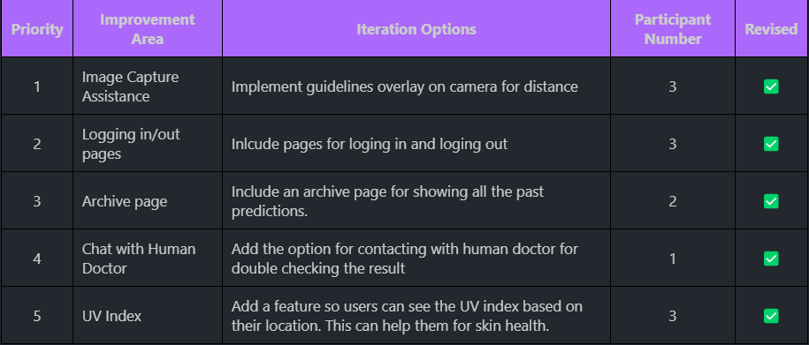
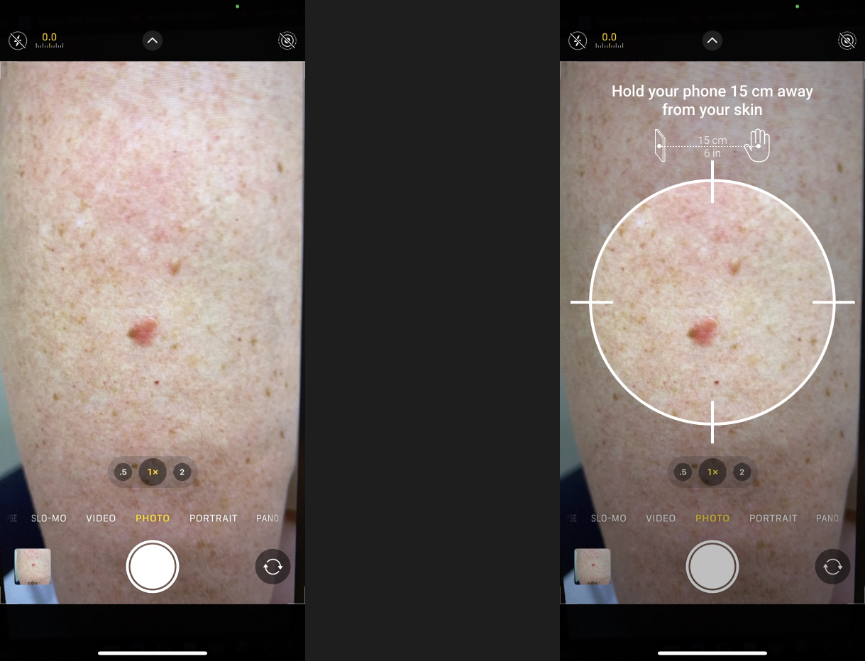
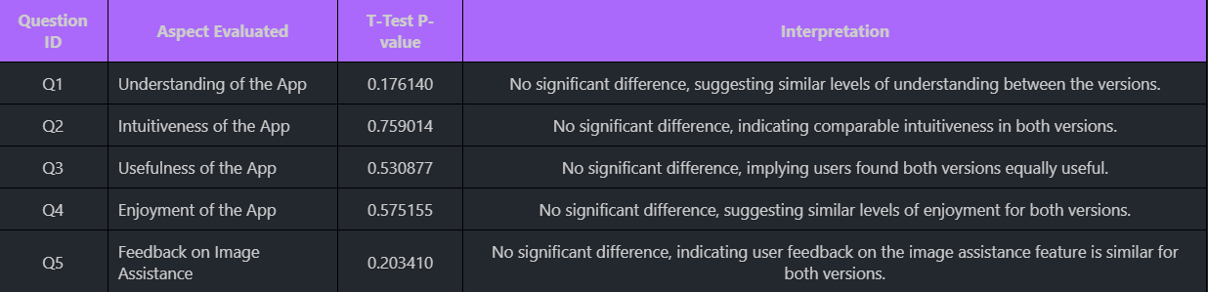
User Study
Human-Centered AI
Much useful feedback was collected during the think-aloud study.
In A/B testing, the version A is the basic app. Version B has extra tools for taking better photos. The test compares both to see if B helps users take clearer pictures for more accurate skin cancer checks.
Hypothesis: Version B will increase the quality of submitted images, improve the accuracy of analyses and enhance user satisfaction.
Based on the t-test, neither version (A or B) can be conclusively considered superior in terms of user experience.

Slide 8
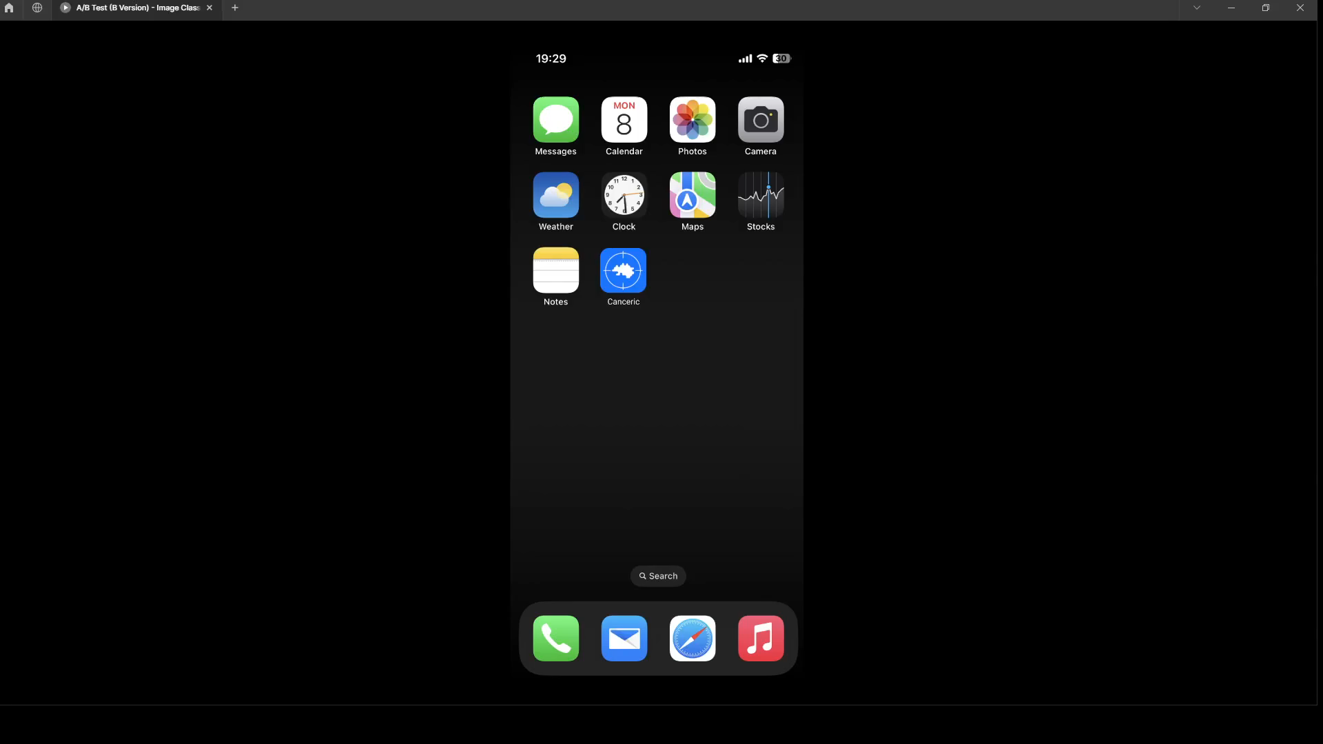
Demo
Human-Centered AI

Slide 9
Thank you!
Any questions?

